Slide 1
Careers Education / PSHCE
Choosing GCSE Options, The ‘Buzz Quiz’ Personality Profiles & Exploring Job Roles

Slide 2
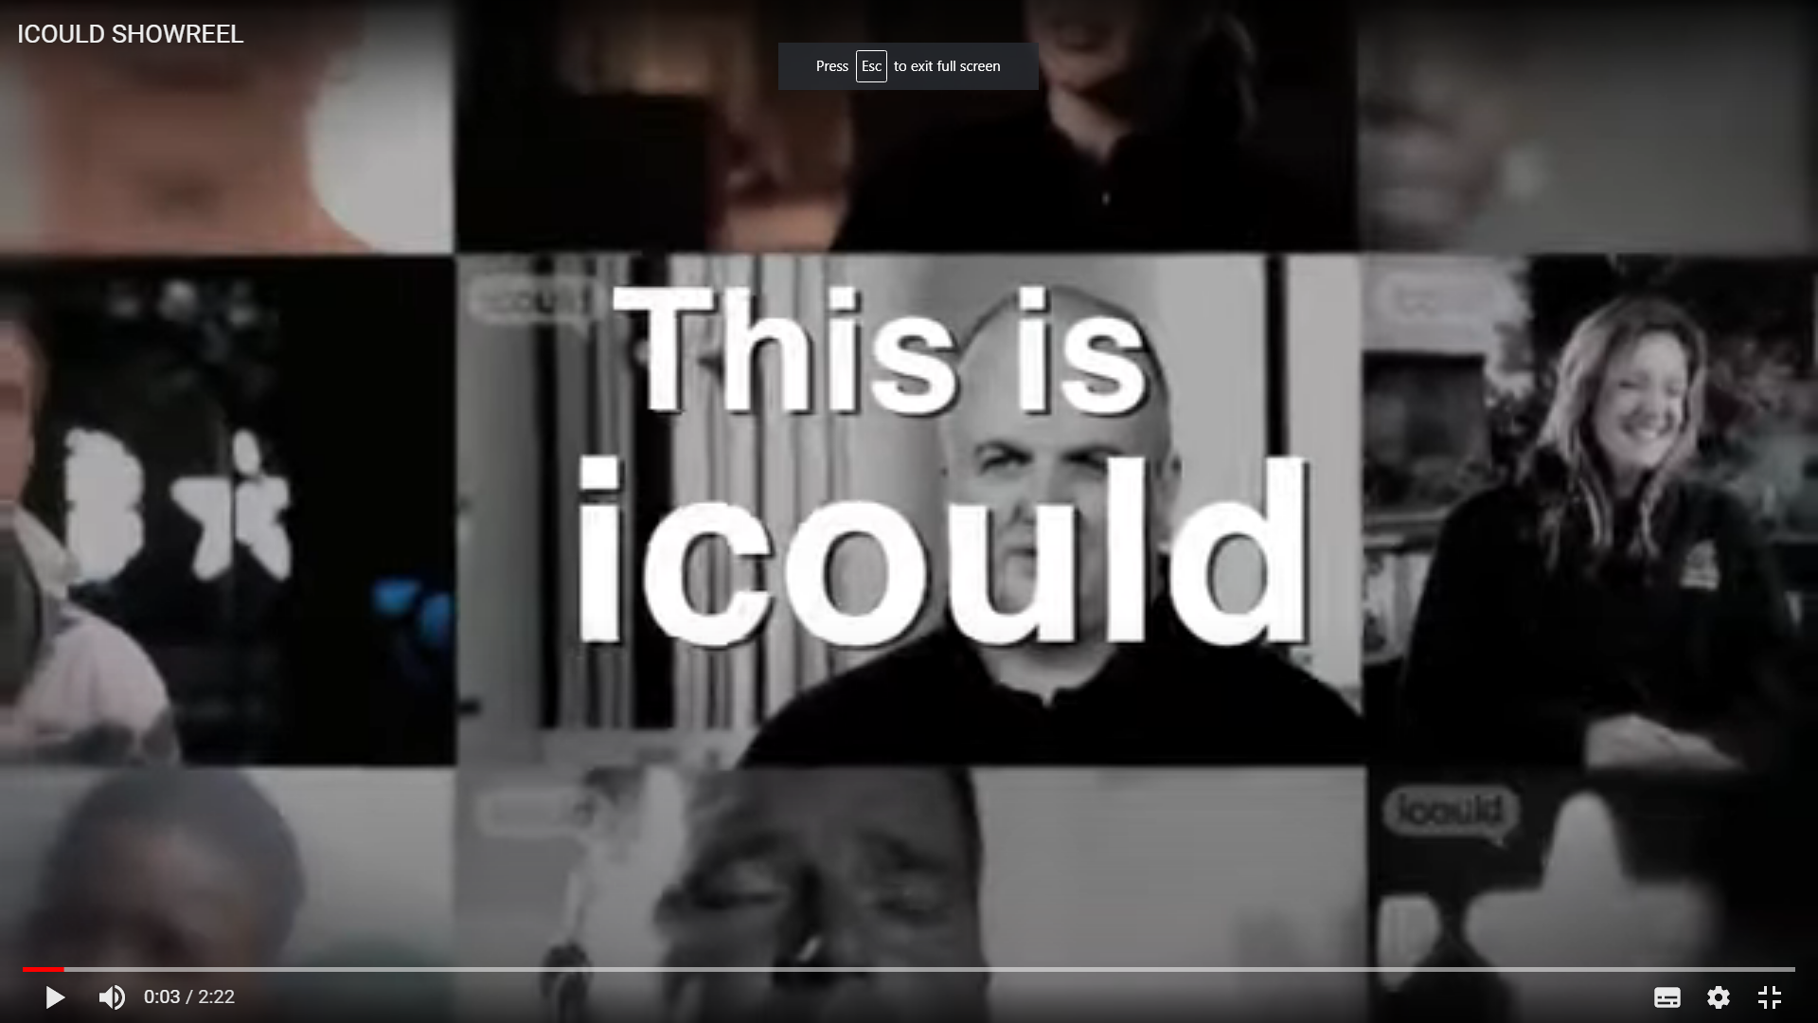
Careers Website Overview
Other features include the Buzz Quiz, which encourages self-reflection and explores links between personality and work, plus a range of written guides and articles covering issues such as GCSE options or university choices; exams and revision; and finding and applying for jobs.
iCould.com uses the power of personal stories to inform young people’s career choices.
The site features over 1000 videos of people talking about their careers – explaining their job role, career path, and how different factors have shaped their direction.
Videos can be filtered by job type or subject and cover a range of sectors and levels, encouraging young people to draw links between school subjects and jobs.
Each video is matched with labour market information (LMI) – such as salary, qualifications and future employment – bringing together first-hand insight with practical next steps.
https://youtu.be/maHdfmeB510
2 Minute Intro to iCould
Notes:
Tutors or Parents need to introduce the iCould website and encourage students to take the Buzz Quiz and then explore the many useful features of the site. The quiz is fun to take and discuss. Tutors and Parents can take the quiz as well and share their own reaction to the animal profile it presents? Moving on, each video is accompanied by relevant advice and labour market information that can be used to discuss the benefits and pitfalls of each particular industry or job role. This is particularly useful when researching unfamiliar roles.

Slide 3
3 Key Features for Year 9
‘Buzz Quiz’ 5 Minute Personality Questionnaire
Advice on Choosing GCSE Options
Exploring Job Role Videos
https://icould.com/explore
by subject or job type,
all with ‘labour market’ information
https://icould.com/buzz-quiz
https://icould.com/stories/choosing-your-gcse-options/
In just a few minutes, this fun quiz can help you:
Discover your strengths and what makes you tick
Understand how others may see you
Explore subject choices and jobs that could suit you
https://icould.com/
& next steps
Notes:
At this stage of their career journey students will be choosing their GCSE options and looking ahead to how their choices will link to further study or job roles in the future. The iCould site has many useful resources that they and their parents can explore. However, there are three key features that should be highlighted.
The Buzz Quiz Animal Personality Questionnaire. This will allow students to reflect on their strengths and career preferences. The summary will suggest subjects and job roles they may be interested in.
2. Advice on Choosing GCSE Options. There are several advice guides that may be useful on the site but there is information about GCSE options.
3. Exploring job role videos – These videos can be explored by Subject or job Type and they are all accompanied by useful Labour Market Information and a breakdown of key facts and figures related to each role. They also come with skills and qualifications required etc.

Slide 4
Choosing Your GCSEs? - Things to think about…
https://youtu.be/d_ssJV_XfjQ
https://www.youtube.com/watch?v=DsLfssAa1OY
2.42 mins
2.40 mins
Notes:
A couple of short videos to stimulate thinking about making the right choices

Slide 5
GCSE Options? Some Dos and Don'ts
DO:
Choose something that you enjoy – you’re going to be studying these subjects for the next 2 years (at least) – and if you enjoy it, you’re more likely to do well.
Choose something that you’re good at – if you’re good at something, you’re more likely to enjoy it, and keep yourself motivated.
Talk to others about your decisions – you have people around you that are there to support your decision making, and it’s really useful to talk to them about your options (teachers, careers advisors, parents, carers, siblings, friends) – they shouldn’t make your decision for you, but can be a great source of advice and alternative perspectives.
Research about your goals and ambitions – if you know vaguely what you want to do as a career, what you want to study at university, or even what you want to do at A-Level, then you should research into this course/profession and ensure that you are taking the relevant GCSE subjects
Keep your options open – if you aren’t sure about what you want to do after your GCSEs, then choose subjects that will open doors for you, whatever you decide to do after school. A good balance of different subjects will keep future options open, give you a good overview, and will help you realise what you are best at for decisions later in your education.
DON’T:
Choose something because your friends are – although this may make your lessons more fun, having your friends around won’t help you when you have to sit an exam in that subject. It’s therefore important not to choose something because others around you are. It also means that when you see your friends outside of lessons, you’ll have more to talk about, and you may even make new friends!
Choose something because you like the teacher – you may not have the same teacher next year, and without that teacher, will you still enjoy the subject? Teachers will leave schools, or may not teach you when you change year groups, so you should never base your decisions on the teacher.
Choose something you don’t like, because someone told you to – it’s great to get advice and support from other people, but it’s also important that you are the one to make the final decision, as you’re the one that will be studying the subject!
Choose a subject because you think it’ll be easy – no subjects are easy, so don’t pick a subject for this reason!
Taken From – Manchester University ‘Gateway’ Careers Resources
https://sites.manchester.ac.uk/gatewaysresources/home/for-year-9/gcse-options-9/
Notes:
These ‘checklists’ could be used as a way of discussing the students’ decision making in more depth.

Slide 6
Other Careers Research sites to explore and investigate
START Profile
https://careers.startprofile.com/page/home-page
Including Info on GCSE Options & lots of careers links
https://careers.startprofile.com/page/gcse-equivalent
BBC Bite Size / iPlayer Careers Programmes – A useful sources of information covering lots of information about the A to Z of jobs etc. https://www.bbc.co.uk/bitesize/careers
National Careers Service
Talk to an Advisor!
https://nationalcareers.service.gov.uk/
Notes:
Get students to make a note of these websites and visit them on their phones and at home to see the range of careers resources available.

Slide 7
Need More Careers Advice?
Contact Mr Mills (Careers Leader / Advisor) – Room PDOF
smills@sandbachschool.org
Notes:
If students need more in-depth guidance then they can use the National Careers Service links or contact me (Mr Mills) at a drop in session during pastoral on a Friday in PDOF or book a one-to-one careers appointment.

